Slide 1


JSON в C++: проектируем тип для работы с JSON значениями
Павел Новиков
@cpp_ape

Slide 2
Plan for this talk
quick overview of JSON
design for a C++ type for working with JSON values
standard containers, std::variant
C++ allocator support

Slide 3
Constraints for this talk
Constraints for the implementation:
use C++17
write as little code as possible (while maintaining reasonable design and performance)
Not in this talk:
JSON string escaping
serialization/stringification
parsing

Slide 4
Overview of JSON
Douglas Crockford specified JSON in the early 2000s.
RFC 8259
null | null
true or false | Boolean
3.14 | number
"hello" | string
[ 1, 2, 3 ] | array (sequence)
{ "key": "value" } | object (dictionary)
primitive types
or
scalar types
structured types
or
collection types

Slide 5
Overview of JSON
JSON-text = ws value ws begin-array = ws %x5B ws ; [ left square bracket begin-object = ws %x7B ws ; { left curly bracket end-array = ws %x5D ws ; ] right square bracket end-object = ws %x7D ws ; } right curly bracket name-separator = ws %x3A ws ; : colon value-separator = ws %x2C ws ; , comma ws = *( %x20 / ; Space %x09 / ; Horizontal tab %x0A / ; Line feed or New line %x0D ) ; Carriage return value = false / null / true / object / array / number / string false = %x66.61.6c.73.65 ; false null = %x6e.75.6c.6c ; null true = %x74.72.75.65 ; true object = begin-object [ member *( value-separator member ) ] end-object member = string name-separator value array = begin-array [ value *( value-separator value ) ] end-array | number = [ minus ] int [ frac ] [ exp ] decimal-point = %x2E ; . digit1-9 = %x31-39 ; 1-9 e = %x65 / %x45 ; e E exp = e [ minus / plus ] 1*DIGIT frac = decimal-point 1*DIGIT int = zero / ( digit1-9 *DIGIT ) minus = %x2D ; - plus = %x2B ; + zero = %x30 ; 0 string = quotation-mark *char quotation-mark char = unescaped / escape ( %x22 / ; " quotation mark U+0022 %x5C / ; \ reverse solidus U+005C %x2F / ; / solidus U+002F %x62 / ; b backspace U+0008 %x66 / ; f form feed U+000C %x6E / ; n line feed U+000A %x72 / ; r carriage return U+000D %x74 / ; t tab U+0009 %x75 4HEXDIG ) ; uXXXX U+XXXX escape = %x5C ; \ quotation-mark = %x22 ; " unescaped = %x20-21 / %x23-5B / %x5D-10FFFF
JSON grammar defined by RFC 8259

Slide 6
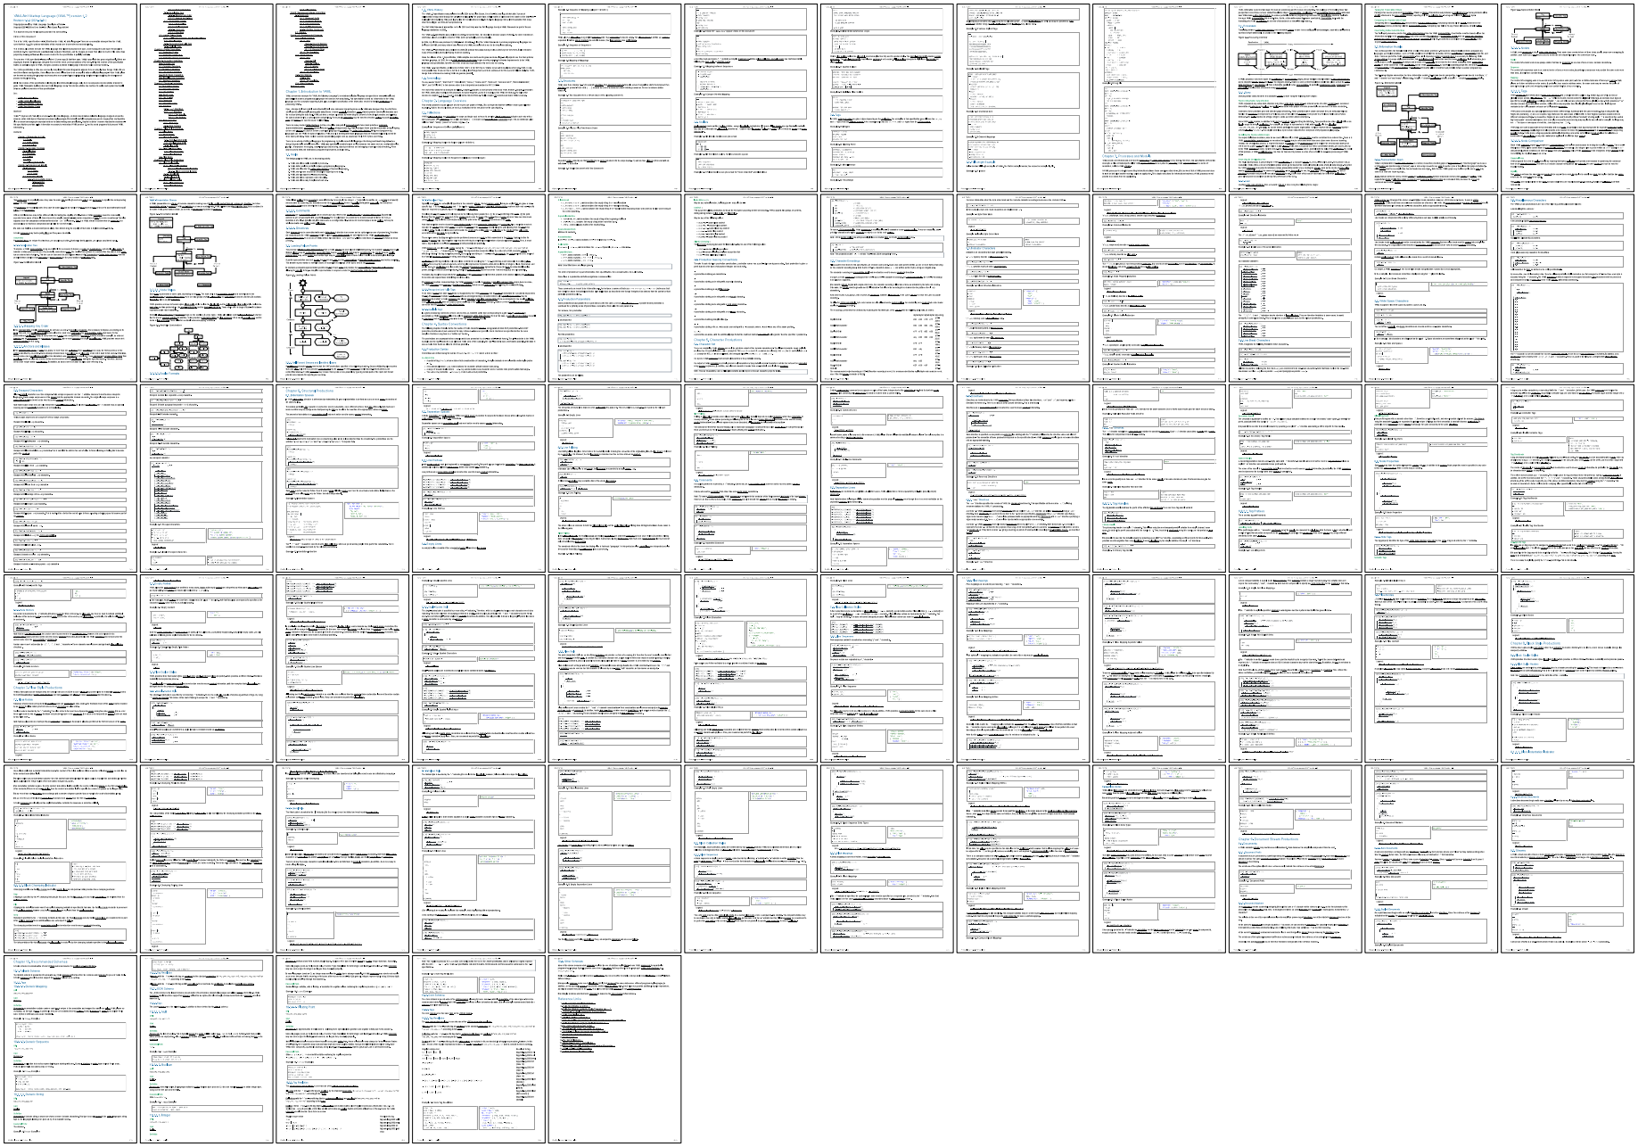
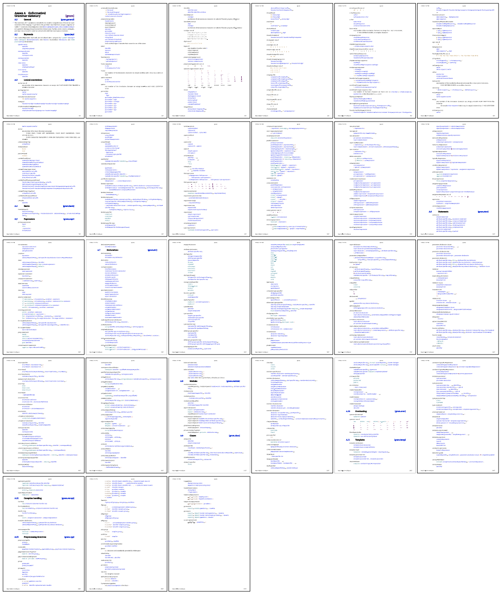
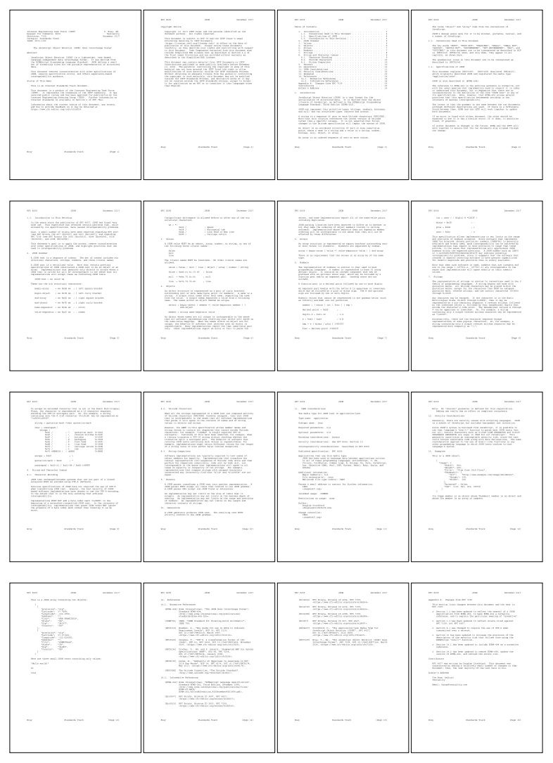
YAML
https://yaml.org/spec/1.2.2/
C++
https://eel.is/c++draft/#gram
entire
RFC 8259

Slide 7
Mapping of JSON types into C++
JSON |  | C++
null | null
Boolean | true or false | bool
number | 3.14 | int64_t, double
string | "hello" | std::string
array | [ 1, 2, 3 ] | std::vector<Value>
object | { "key": "value" } | std::unordered_map<std::string, Value>
keys are unordered

Slide 8
Mapping of JSON types into C++
C++17:
char — (usually) 8 bit integer type
namespace std {
using string = basic_string<char, char_traits<char>, allocator<char>>;
}
C++20:
char8_t — (at least) 8 bit integer type able to accommodate UTF-8 code units
namespace std {
using u8string = basic_string<char8_t, char_traits<char8_t>, allocator<char8_t>>;
}
What about interoperability between std::string and std::u8string? 🤷‍♀️

Slide 9
Mapping of JSON types into C++
JSON value is a union type
std::variant<std::monostate,
bool,
int64_t,
double,
std::string,
std::vector<Value>,
std::unordered_map<String, Value>>
null
struct Value;

Slide 10
Value type
struct Value {
using Null = std::monostate;
using Boolean = bool;
using String = std::string;
using Array = std::vector<Value>;
using Object = std::unordered_map<String, Value>;
using Variant =
std::variant<Null, Boolean, int64_t, double, String, Array, Object>;
//...
private:
//...
Variant m_data;
};

Slide 11
Value type
Value v; // default ctor
Value boolean = true;
Value string = "hello";
Value number = 42;

Slide 12
struct Value {
//...
Value() = default;
template<typename T,
std::enable_if_t<!std::is_same_v<detail::RemoveCVRef<T>, Value> &&
std::is_convertible_v<T&&, Variant>, int> = 0>
Value(T &&v) noexcept(std::is_nothrow_constructible_v<Variant, T&&>) :
m_data{ std::forward<T>(v) }
{}
Value(std::string_view s) :
m_data{ std::in_place_type<String>, s }
{}
//...
};
namespace detail {
template<typename T>
using RemoveCVRef = std::remove_cv_t<std::remove_reference_t<T>>;
}
safe to put into template paremeters

Slide 13
struct Value {
//...
Value() = default;
template<typename T>
requires (!std::is_same_v< std::remove_cvref<T>, Value> &&
std::is_convertible_v<T&&, Variant>)
Value(T &&v) noexcept(std::is_nothrow_constructible_v<Variant, T&&>) :
m_data{ std::forward<T>(v) }
{}
Value(std::string_view s) :
m_data{ std::in_place_type<String>, s }
{}
//...
};
C++20

Slide 14
struct Value {
//...
template<typename T>
std::enable_if_t<!std::is_same_v<detail::RemoveCVRef<T>, Value> &&
std::is_convertible_v<T&&, Variant>, Value>
Value &operator=(T &&v)
noexcept(std::is_nothrow_assignable_v<Variant, T&&>) {
variant() = std::forward<T>(v);
return *this;
}
Value &operator=(std::string_view s) {
variant().template emplace<String>(s);
return *this;
}
//...
};
need to be
the return type

Slide 15
struct Value {
//...
template<typename T,
std::enable_if_t<!std::is_same_v<detail::RemoveCVRef<T>, Value> &&
std::is_convertible_v<T&&, Variant>, int> = 0>
Value &operator=(T &&v)
noexcept(std::is_nothrow_assignable_v<Variant, T&&>);
//...
};
Value v;
v.operator=<bool, 0>(true);
v.operator=<bool, 1>(true);
v.operator=<bool, 2>(true);
v.operator=<bool, 3>(true);
v.operator=<bool, 4>(true);

Slide 16
struct Value {
//...
template<typename T>
std::enable_if_t<!std::is_same_v<detail::RemoveCVRef<T>, Value> &&
std::is_convertible_v<T&&, Variant>, Value>
&operator=(T &&v)
noexcept(std::is_nothrow_assignable_v<Variant, T&&>) {
variant() = std::forward<T>(v);
return *this;
}
Value &operator=(std::string_view s) {
variant().template emplace<String>(s);
return *this;
}
//...
};

Slide 17
struct Value {
//...
template<typename T>
requires (!std::is_same_v< std::remove_cvref<T>, Value> &&
std::is_convertible_v<T&&, Variant>)
Value &operator=(T &&v)
noexcept(std::is_nothrow_assignable_v<Variant, T&&>) {
variant() = std::forward<T>(v);
return *this;
}
Value &operator=(std::string_view s) {
variant().template emplace<String>(s);
return *this;
}
//...
};
C++20

Slide 18
struct Value {
//...
Value() = default;
template<typename T,
std::enable_if_t<!std::is_same_v<detail::RemoveCVRef<T>, Value> &&
std::is_convertible_v<T&&, Variant>, int> = 0>
Value(T &&v) noexcept(std::is_nothrow_constructible_v<Variant, T&&>);
Value(std::string_view s);
template<typename T>
std::enable_if_t<!std::is_same_v<detail::RemoveCVRef<T>, Value> &&
std::is_convertible_v<T&&, Variant>, Value>
Value &operator=(T &&v);
Value &operator=(std::string_view s);
//...
};
Which rule?
destructor
copy constructor
copy assignment
move constructor
move assignment
none of the above
rule of three
rule of five
rule of zero

Slide 19
struct Value {
//...
friend bool operator==(const Value &a, const Value &b) {
return a.variant() == b.variant();
}
friend bool operator!=(const Value &a, const Value &b) {
return a.variant() != b.variant();
}
//...
};

Slide 20
struct Value {
//...
friend bool operator==(const Value&, const Value&) = default;
//...
};
C++20
operator!= is synthesized from operator==

Slide 21
struct Value {
//...
[[nodiscard]] const Variant &variant() const& noexcept { return m_data; }
[[nodiscard]] Variant &variant() & noexcept { return m_data; }
[[nodiscard]] Variant &&variant() && noexcept {
return std::move(m_data);
}
[[nodiscard]] const Variant &&variant() const&& noexcept {
return std::move(m_data);
}
operator const Variant&() const& noexcept { return m_data; }
operator Variant&() & noexcept { return m_data; }
operator Variant&&() && noexcept { return std::move(m_data); }
operator const Variant&&() const&& noexcept { return std::move(m_data); }
//...
};

Slide 22
Value type
using Object = Value::Object;
using Array = Value::Array;
using String = Value::String;
using Boolean = bool;
using Null = std::monostate;
using Variant = Value::Variant;

Slide 23
Value type
void print(const Value &value) {
std::visit(Overloaded{
[](Null) { std::cout << "null"; },
[](bool b) { std::cout << "boolean: " << (b ? "true" : "false"); },
[](int64_t i) { std::cout << "integer: " << i; },
[](double d) { std::cout << "decimal: " << d; },
[](const std::string &s) { std::cout << "string: " << s; },
[](const Array&) { std::cout << "array"; },
[](const Object&) { std::cout << "object"; }
}, value.variant());
std::cout << '\n';
}
template<typename... F>
struct Overloaded : F... { using F::operator()...; };
template<typename... F>
Overloaded(F...) -> Overloaded<F...>; // needed until C++20

Slide 24
Value type
Value boolean = true;
print(boolean);
output:
Clang 18 -std=c++17 | MSVC (VS 2022) -std:c++17
boolean: true | boolean: true

Slide 25
Value type
Value string = "hello";
print(string);
output:
Clang 18 -std=c++17 | MSVC (VS 2022) -std:c++17
string: hello | boolean: true

Slide 26
Value type
Value number = 42;
print(number);
output:
Clang 18 -std=c++17 | MSVC (VS 2022) -std:c++17
integer: 42 | error : no viable conversion from 'int' to 'Value'

Slide 27
In C++17 variant alternative is chosen as if by overload resolution:
void test(std::monostate); // Null
void test(bool); // Boolean
void test(int64_t); // integer
void test(double); // decimal
void test(std::string); // String
void test(std::vector<Value>); // Array
void test(std::unordered_map<String, Value>) // Object
test(true); // calls test(bool)
test("hello"); // calls test(bool)
test(42); // error : call to 'test' is ambiguous
This nonsense is fixed in P0608.
MS left the original behavior in
-std=c++17 mode
for backwards compatibility.

Slide 28
Value type
#if defined(_MSC_VER) && \
(defined(_MSVC_LANG) && _MSVC_LANG > __cplusplus && \
_MSVC_LANG == 201703L || \
__cplusplus == 201703L)
#define NEED_WORKAROUND_FOR_UNIMPLEMENTED_P0608
#endif

Slide 29
struct Value {
//...
Value() = default;
template<typename T,
std::enable_if_t<!std::is_same_v<detail::RemoveCVRef<T>, Value> &&
std::is_convertible_v<T&&, Variant>, int> = 0>
Value(T &&v) noexcept(std::is_nothrow_constructible_v<Variant, T&&>);
Value(std::string_view s);
#if defined(NEED_WORKAROUND_FOR_UNIMPLEMENTED_P0608)
Value(const char *s) : m_data{ std::in_place_type<String>, s } {}
Value(int i) noexcept : m_data{ std::in_place_type<int64_t>, i } {}
#endif
//...
};

Slide 30
//...
template<typename T>
std::enable_if_t<!std::is_same_v<detail::RemoveCVRef<T>, Value> &&
std::is_convertible_v<T&&, Variant>,
Value> &operator=(T &&v);
Value &operator=(std::string_view s);
#if defined(NEED_WORKAROUND_FOR_UNIMPLEMENTED_P0608)
Value &operator=(const char *s) {
variant().template emplace<String>(s);
return *this;
}
Value &operator=(int i) noexcept {
variant().template emplace<int64_t>(i);
return *this;
}
#endif
//...

Slide 31
Value type
 | output:
Value boolean = true; print(boolean); | boolean: true
Value string = "hello"; print(string); | string: hello
Value number = 42; print(number); | integer: 42

Slide 32
using json = nlohmann::json;
json j2 = {
{"pi", 3.141},
{"happy", true},
{"name", "Niels"},
{"nothing", nullptr},
{"answer", {
{"everything", 42}
}},
{"list", {1, 0, 2}},
{"object", {
{"currency", "USD"},
{"value", 42.99}
}}
};

Slide 33
json x = {
{}
};
std::cout << x.dump(2) << '\n';
outputs:
[
null
]

Slide 34
json x = {
{ "value" }
};
std::cout << x.dump(2) << '\n';
outputs:
[
[
"value"
]
]

Slide 35
json x = {
{ "key?", "value?" }
};
std::cout << x.dump(2) << '\n';
outputs:
{
"key?": "value?"
}

Slide 36
json x = {
{ "key?", "value?", "oops" }
};
std::cout << x.dump(2) << '\n';
outputs:
[
[
"key?",
"value?",
"oops"
]
]

Slide 37
Value type
Value json = Object{
{ "null", Null{} },
{ "boolean", true },
{ "integer", 42 },
{ "decimal", 3.14 },
{ "string", "hello" },
{ "array", Array{
1, 2, 3
} },
{ "nested object", Object{
{ "foo", "bar" }
} }
};
std::unordered_map<String, Value>
std::vector<Value>

Slide 38
struct Value {
//...
[[nodiscard]] bool isObject() const noexcept {
return std::holds_alternative<Object>(variant());
}
[[nodiscard]] const Object &asObject() const& {
return std::get<Object>(variant());
}
[[nodiscard]] Object &asObject() & {
return std::get<Object>(variant());
}
[[nodiscard]] Object &&asObject() && {
return std::move(std::get<Object>(variant()));
}
//...
};

Slide 39
struct Value {
//...
[[nodiscard]] bool isArray() const noexcept {
return std::holds_alternative<Array>(variant());
}
[[nodiscard]] const Array &asArray() const& {
return std::get<Array>(variant());
}
[[nodiscard]] Array &asArray() & {
return std::get<Array>(variant());
}
[[nodiscard]] Array &&asArray() && {
return std::move(std::get<Array>(variant()));
}
//...
};

Slide 40
struct Value {
//...
[[nodiscard]] bool isString() const noexcept {
return std::holds_alternative<String>(variant());
}
[[nodiscard]] const String &asString() const& {
return std::get<String>(variant());
}
[[nodiscard]] String &asString() & {
return std::get<String>(variant());
}
[[nodiscard]] String &&asString() && {
return std::move(std::get<String>(variant()));
}
//...
};

Slide 41
struct Value {
//...
[[nodiscard]] bool isDouble() const noexcept {
return std::holds_alternative<double>(variant());
}
[[nodiscard]] double asDouble() const {
return std::get<double>(variant());
}
[[nodiscard]] double &asDouble() {
return std::get<double>(variant());
}
//...
};

Slide 42
struct Value {
//...
[[nodiscard]] bool isInt() const noexcept {
return std::holds_alternative<int64_t>(variant());
}
[[nodiscard]] int64_t asInt() const {
return std::get<int64_t>(variant());
}
[[nodiscard]] int64_t &asInt() {
return std::get<int64_t>(variant());
}
//...
};

Slide 43
struct Value {
//...
[[nodiscard]] bool isBool() const noexcept {
return std::holds_alternative<Boolean>(variant());
}
[[nodiscard]] Boolean asBool() const {
return std::get<Boolean>(variant());
}
[[nodiscard]] Boolean &asBool() {
return std::get<Boolean>(variant());
}
//...
};

Slide 44
struct Value {
//...
[[nodiscard]] bool isNull() const noexcept {
return std::holds_alternative<Null>(variant());
}
//...
};

Slide 45
Value type
Value json = Object{
//...
};
assert(json.isObject());
auto &object = json.asObject();
assert(object["array"].isArray());
auto &array = object["array"].asArray();
array[0]; // can do whatever std::vector allows
assert(object["nested object"].isObject());
auto &nested = object["nested object"].asObject();
nested["foo"]; // can do whatever std::unordered_map allows

Slide 46
using json = nlohmann::json;
json j2 = {
//...
{"list", {1, 0, 2}},
//...
};
j2["list"][0];

Slide 47

using json = nlohmann::json;
json x; // null
x[0]; // now it's an array: [ null ]
json y; // null
y["foo"]; // now it's an object: { "foo": null }
json z = 42;
z["foo"]; // compiles, throws an exception

Slide 48
Value type
Value x = Object{
{ "items", Array{ 1, 2, 3 } }
};
Value *item = x.resolve("items", 0);
if (item)
print(*item); // use *item
implies that x is an object
implies that
x.asObject()["items"]
is an array

Slide 49
Value type
Value y = Array{
Object{ { "foo", 1 } }, "two", 3
};
Value *foo = y.resolve(0, "foo");
if (foo)
print(*foo); // use *foo
implies that y is an array
implies that
y.asArray()[0]
is an object

Slide 50
Value z = Array{
Object{
{ "foo", Object{
{ "bar", Array{ 1, 2, 3 } }
} }
},
42
};
auto *v = z.resolve(0, "foo", "bar", 2);
if (v)
print(*v); // use *v

Slide 51
Value z = Array{
Object{
{ "foo", Object{
{ "bar", Array{ 1, 2, 3 } }
} }
},
42
};
auto *v = z.resolve(1);
if (v)
print(*v); // use *v

Slide 52
Value z = Array{
Object{
{ "foo", Object{
{ "bar", Array{ 1, 2, 3 } }
} }
},
42
};
auto *v = z.resolve(0, "foo", 2);
if (v)
print(*v); // use *v
???

Slide 53
struct Value {
//...
private:
const Value *resolveImpl(size_t index) const noexcept {
auto *array = std::get_if<Array>(&variant());
if (array && index < array->size())
return &(*array)[index];
return nullptr;
}
const Value *resolveImpl(const String &key) const noexcept {
if (auto *object = std::get_if<Object>(&variant())) {
if (auto i = object->find(key); i != object->end())
return &i->second;
}
return nullptr;
}
//...

Slide 54
Value type
struct Value {
//...
template<typename... T>
[[nodiscard]] std::enable_if_t<sizeof...(T) >= 1 &&
detail::AreTypesConvertibleToStringXorSizeT<T&&...>,
const Value*> resolve(T&&... refTokens) const noexcept {
const Value *value = this;
(value = value->resolveImpl(std::forward<T>(refTokens)) && ...);
return value;
}
//...
};

Slide 55
Value type
struct Value {
//...
template<typename... T>
requires ( sizeof...(T) >= 1 &&
detail::AreTypesConvertibleToStringXorSizeT<T&&...>)
[[nodiscard]] const Value* resolve(T&&... refTokens) const noexcept {
const Value *value = this;
((value = value->resolveImpl(std::forward<T>(refTokens))) && ...);
return value;
}
//...
};
C++20
namespace detail {
template<typename... T>
inline constexpr bool AreTypesConvertibleToStringXorSizeT =
((std::is_convertible_v<T, std::string> != // exclusive OR
std::is_convertible_v<T, size_t>) && ...);
}

Slide 56
Value type
struct Value {
//...
template<typename... T>
requires ( sizeof...(T) >= 1 &&
detail::AreTypesConvertibleToStringXorSizeT<T&&...>)
[[nodiscard]] const Value* resolve(T&&... refTokens) const noexcept {
const Value *value = this;
(static_cast<bool>(
value = value->resolveImpl(std::forward<T>(refTokens))
) && ...);
return value;
}
//...
};
C++20

Slide 57
Value type
struct Value {
//...
template<typename... T>
requires ( sizeof...(T) >= 1 &&
detail::AreTypesConvertibleToStringXorSizeT<T&&...>)
[[nodiscard]] const Value* resolve(T&&... refTokens) const noexcept {
const Value *value = this;
(void)(static_cast<bool>(
value = value->resolveImpl(std::forward<T>(refTokens))
) && ...);
return value;
}
//...
};
C++20

Slide 58
Value type
struct Value {
//...
template<typename... T>
requires (sizeof...(T) >= 1 &&
detail::AreTypesConvertibleToStringXorSizeT<T&&...>)
[[nodiscard]] Value* resolve(T&&... refTokens) noexcept {
return const_cast<Value*>(
std::as_const(*this).resolve(std::forward<T>(refTokens)...)
);
}
//...
};
C++20
Value x = Object{
{ "items", Array{ 1, 2, 3 } }
};
Value *item = x.resolve("items", 0);
if (item)
print(*item); // use *item

Slide 59
Value type
struct Value {
//...
using Array = std::vector<Value>;
using Object = std::unordered_map<String, Value>;
//...
private:
//...
Variant m_data;
};
Value is incomplete at this point

Slide 60
Value type
std::vector has to support incomplete types according to the standard
std::unordered_map does not have to support incomplete types, but de facto supports them in all major implementations of the C++ standard library
except for libstdc++ versions <12

Slide 61
Value type
struct Value {
//...
private:
//...
#if !defined(_GLIBCXX_RELEASE) || _GLIBCXX_RELEASE >= 12
Variant m_data;
#else
struct Workaround final {
//...
} m_data;
#endif
};

Slide 62
Value type
struct Workaround final {
//...
private:
using DummyUnorderedMap = std::unordered_map<String, Array>;
using DummyVariant = std::variant<Null, Boolean, int64_t,
double, String, Array,
DummyUnorderedMap>;
alignas(DummyVariant) uint8_t storage[sizeof(DummyVariant)];
} m_data;
std::aligned_storage is deprecated in C++23

Slide 63
struct Workaround final {
Workaround() noexcept { ::new(&storage) Variant{}; }
Workaround(const Workaround &other) {
::new(&storage) Variant{ other.operator const Variant&() };
}
Workaround(Workaround &&other)
noexcept(std::is_nothrow_move_constructible_v<Variant>) {
::new(&storage) Variant{ std::move(other.operator Variant&()) };
}
template<typename... T>
Workaround(T&&... v)
noexcept(std::is_nothrow_constructible_v<Variant, T&&...>) {
::new(&storage) Variant{ std::forward<T>(v)... };
}
//...
} m_data;

Slide 64
struct Workaround final {
//...
~Workaround() {
static_assert(sizeof(DummyVariant) == sizeof(Variant));
static_assert(alignof(DummyVariant) == alignof(Variant));
operator Variant&().~Variant();
}
auto &operator=(const Workaround &other) {
return operator Variant&() = other.operator const Variant&();
}
auto &operator=(Workaround &&other)
noexcept(std::is_nothrow_move_assignable_v<Variant>) {
return operator Variant&() = std::move(other.operator Variant&());
}
//...
} m_data;

Slide 65
struct Workaround final {
Workaround() noexcept;
Workaround(const Workaround &other);
Workaround(Workaround &&other)
noexcept(std::is_nothrow_move_constructible_v<Variant>);
template<typename... T>
Workaround(T&&... v)
noexcept(std::is_nothrow_constructible_v<Variant, T&&...>);
~Workaround();
auto &operator=(const Workaround &other);
auto &operator=(Workaround &&other)
noexcept(std::is_nothrow_move_assignable_v<Variant>);
//...
} m_data;
Which rule?
Rule of five

Slide 66
struct Workaround final {
//...
operator const Variant&() const& noexcept {
return *std::launder(reinterpret_cast<const Variant*>(&storage));
}
operator Variant&() & noexcept {
return *std::launder(reinterpret_cast<Variant*>(&storage));
}
operator Variant&&() && noexcept {
return std::move(operator Variant&());
}
operator const Variant&&() const&& noexcept {
return std::move(operator const Variant&());
}
//...
} m_data;

Slide 67
Value type
struct Value {
//...
private:
//...
#if !defined(_GLIBCXX_RELEASE) || _GLIBCXX_RELEASE >= 12
Variant m_data;
#else
struct Workaround final {
//...
} m_data;
#endif
};

Slide 68
visit()
Value v;
auto visitor = [](auto&&) {/*...*/};
std::visit(visitor, v); // does not work
std::visit(visitor, v.variant());
visit(visitor, v);

Slide 69
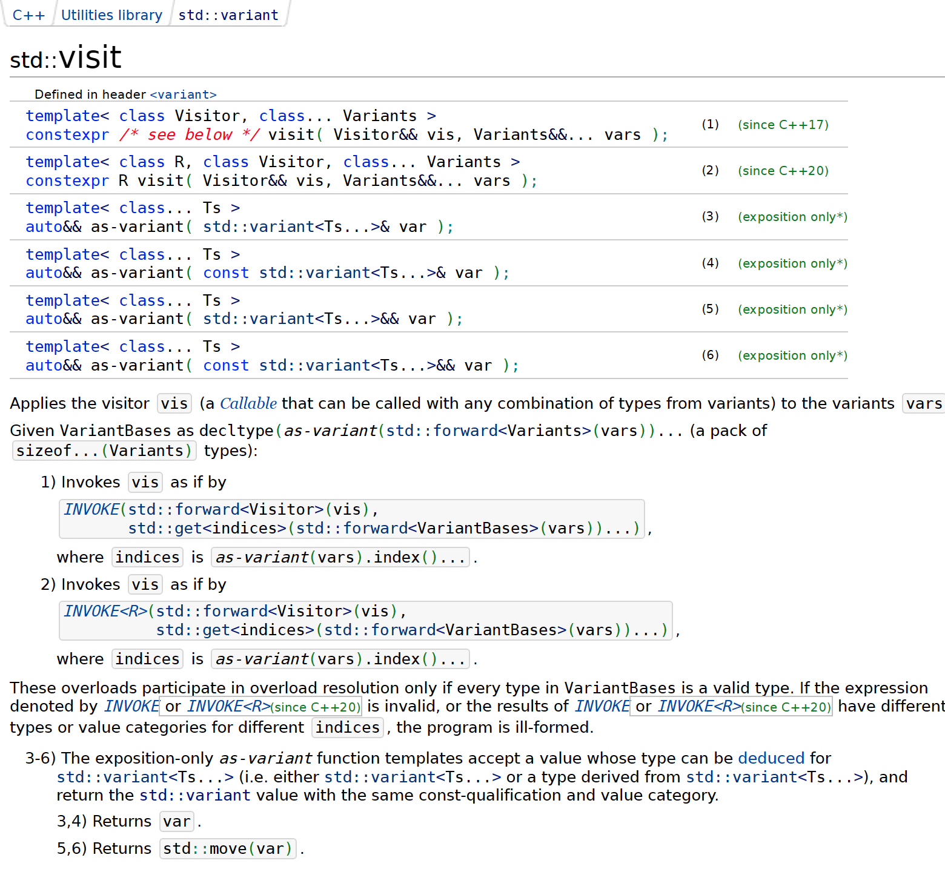
Argument to std::visit() can be either
std::variant<T...>
or
a type derived from std::variant<T...>

Slide 70
visit()
C++20
template<typename F, typename T>
requires (std::is_base_of_v<detail::RawBaseValueType<T>,
std::remove_cvref_t<T>>)
decltype(auto) visit(F &&f, T &&value) {
using BaseValueType = detail::RawBaseValueType<T>;
return std::visit(std::forward<F>(f),
std::forward<T>(value).BaseValueType::variant());
}

Slide 71
visit()
C++20
namespace detail {
void GetValue(...); // intentionally not implemented
Value GetValue(const Value&); // intentionally not implemented
template<typename T>
using RawBaseValueType =
decltype(GetValue(std::declval<std::remove_cvref_t<T>>()));
}

Slide 72
decltype(auto)
T
returns T as deduced in a call
test(expr)
to template function
template<typename T>
void test(T);
auto foo() {
return expr;
}
const auto &bar() {
return expr;
}
decltype(expr) baz() {
return expr;
}
T
returns T as deduced in a call
test(expr)
to template function
template<typename T>
void test(const T&);
auto

Slide 73
visit()
C++20
template<typename F, typename T>
requires (std::is_base_of_v<detail::RawBaseValueType<T>,
std::remove_cvref_t<T>>)
decltype(auto) visit(F &&f, T &&value) {
using BaseValueType = detail::RawBaseValueType<T>;
return std::visit(std::forward<F>(f),
std::forward<T>(value).BaseValueType::variant());
}

Slide 74
Allocator support
struct Value {
using Null = std::monostate;
using Boolean = bool;
using String = std::string;
using Array = std::vector<Value>;
using Object = std::unordered_map<String, Value>;
using Variant =
std::variant<Null, Boolean, int64_t, double, String, Array, Object>;
//...
};

Slide 75
namespace detail {
template<typename Allocator, typename T>
using ReboundAllocator =
typename std::allocator_traits<Allocator>::template rebind_alloc<T>;
}
template<typename Allocator>
struct BasicValue {
using Null = std::monostate;
using Boolean = bool;
using String = std::basic_string<char, std::char_traits<char>,
detail::ReboundAllocator<Allocator, char>>;
using Array = std::vector<BasicValue,
detail::ReboundAllocator<Allocator, BasicValue>>;
using Object = std::unordered_map<String, BasicValue,
std::hash<String>, std::equal_to<String>,
detail::ReboundAllocator<Allocator,
std::pair<const String, BasicValue>>>;
using Variant =
std::variant<Null, Boolean, int64_t, double, String, Array, Object>;
//...
};

Slide 76
Allocator support
template<typename Allocator>
struct BasicValue {
//...
BasicValue(const Allocator&) noexcept {}
BasicValue(const BasicValue &other, const Allocator &a) :
m_data{ construct(other.variant(), a) } {}
BasicValue(BasicValue &&other, const Allocator &a) :
m_data{ construct(std::move(other.variant()), a) } {}
//...
};
uses-allocator machinery support

Slide 77
template<typename V>
Variant construct(V &&other, const Allocator &a) {
if (other.valueless_by_exception())
return std::forward<V>(other);
return std::visit([&a](auto &&val) {
using U = decltype(val);
using T = detail::RemoveCVRef<U>;
if constexpr (std::is_same_v<T, Object> ||
std::is_same_v<T, Array> ||
std::is_same_v<T, String>) {
return Variant{ std::in_place_type<T>, std::forward<U>(val), a };
}
else {
return Variant{ std::in_place_type<T>, val };
}
}, std::forward<V>(other));
}

Slide 78
Allocator support
template<typename Allocator>
struct BasicValue {
//...
};
using Value = BasicValue<std::allocator<char>>;
namespace std {
template<typename A1, typename A2> // uses-allocator machinery support
struct uses_allocator<BasicValue<A1>, A2> : true_type {};
}

Slide 79
Allocator support
struct Workaround final {
//...
private:
using DummyUnorderedMap = std::unordered_map<String, Array,
std::hash<String>, std::equal_to<String>,
detail::ReboundAllocator<Allocator,
std::pair<const String, Array>>>;
using DummyVariant = std::variant<Null, Boolean, int64_t,
double, String, Array,
DummyUnorderedMap>;
alignas(DummyVariant) uint8_t storage[sizeof(DummyVariant)];
} m_data;

Slide 80
Allocator support
C++20
namespace detail {
void GetValue(...); // intentionally not implemented
template<typename Allocator>
BasicValue<Allocator> GetValue(const BasicValue<Allocator>&);
template<typename T>
using RawBaseValueType =
decltype(GetValue(std::declval<std::remove_cvref_t<T>>()));
}

Slide 81


Most Malleable Memory Management Method in C++ by Björn Fahller
https://youtu.be/ptMFLSAkRj0

Slide 82
Allocator support
struct Foo {
Value v;
std::vector<int> bar;
};
const Array a;
Value c;
c = a;
Clang (any version) + libstdc++ version <12:
error: call to implicitly-deleted copy constructor of
'std::pair<const std::basic_string<char>, BasicValue<std::allocator<char>>>'
https://github.com/llvm/llvm-project/issues/84487
[clang] fails to compile valid code involving variant and unordered_map with
libstdc++ version <12

Slide 83
Allocator support
#if defined(_GLIBCXX_RELEASE) && _GLIBCXX_RELEASE < 12 && \
defined(__clang__)
// clang needs this for some reason
static_assert(std::is_copy_constructible_v<Value>);
#endif
🩹

Slide 84
What we've covered
implemented a variant-like value type to work with JSON values
rule of zero
worked around bogus variant construction/assignment in MS implementation (fixed within P0608)
implemented rich interface that's easy to use correctly and hard to use incorrectly
worked around inability to use incomplete types (std::unordered_map in libstdc++ versions <12)
rule of five
allocator support, uses-allocator functionality support
worked around Clang compilation bug with libstdc++ versions <12

Slide 85

ONE DOES NOT SIMPLY
WRITE A JSON LIBRARY IN C++

Slide 86
minjsoncpp
Minimalistic JSON C++ library
https://github.com/toughengineer/minjsoncpp

Slide 87

JSON в C++: проектируем тип для работы с JSON значениями
Павел Новиков
@cpp_ape
Slides: bit.ly/3WYVRkd

Slide 88
References
RFC 8259: The JavaScript Object Notation (JSON) Data Interchange Format https://datatracker.ietf.org/doc/html/rfc8259
“A sane variant converting constructor” by Zhihao Yuan https://wg21.link/p0608
Deprecate std::aligned_storage and std::aligned_union by CJ Johnson https://wg21.link/p1413
Most Malleable Memory Management Method in C++ by Björn Fahller https://www.youtube.com/watch?v=ptMFLSAkRj0
[clang] fails to compile valid code involving variant and unordered_map with libstdc++ version <12 https://github.com/llvm/llvm-project/issues/84487
minjsoncpp — Minimalistic JSON C++ library https://github.com/toughengineer/minjsoncpp

